Slide 1


Stack Organization (Memory Stack) Session No.: 16 Course Name: Computer Organization and Architecture Course Code: R1UC305T Instructor Name: Mr. Piyoush Kumar Duration: 50 Min. Date of Conduction of Class:

Slide 2
Learning Outcome
Explain stack operations for the memory stack .
Differentiate the register stack and memory stack.

Slide 3
Session Outline
1 Memory Stack Organization
2 Memory Stack Operations
3 Register Stack Vs Memory Stack
4 Activity-1 (Think Pair Share)
5 Activity-2 (Hands-on)
6 Conclusion

Slide 4
Recap
Register stack operations?
Role of stack pointer?
Applications of register stack organization? '

Slide 5
Open Question:
* How does the Memory Stack work?

Slide 6
Memory Stack Organization
Stack: Also Based on the LIFO Principle
Implemented in main memory
Stack Pointer: Stores the address of the top of the stack
Stack can grow up to the memory size
Slower access because memory operations take more cycles.
Structure: A memory stack consists of:
Main Memory: Stores stack elements (data/addresses).
Stack Pointer (SP): A CPU register that always holds the address of the top element in the stack.
Control Logic: Manages PUSH/POP operations and detects overflow/underflow.

Slide 7
Memory Stack Operations
Stack Growth Direction
Two ways:
1. Incremental Stack (Grows Upwards):
* Stack starts at a lower memory address.
* PUSH → SP = SP + 1, new element stored at M[SP].
* POP → element taken from M[SP], then SP = SP - 1.
2. Decremental Stack (Grows Downwards):
* Stack starts at a higher memory address.
* PUSH → SP = SP - 1, new element stored at M[SP].
* POP → element taken from M[SP], then SP = SP + 1.

Slide 8
Memory Stack Operations
PUSH Operation (Insert element)
-Decrement SP (if stack grows downward) or increment SP (if stack grows upward).
-Store the data at the new address M[SP].
-Example Instruction:
PUSH R1 → SP = SP - 1; M[SP] = R1
POP Operation (Remove element)
-Retrieve element from M[SP].
-Increment SP (if downward stack) or decrement SP (if upward stack).
-Example Instruction:
POP R1 → R1 = M[SP]; SP = SP + 1

Slide 9
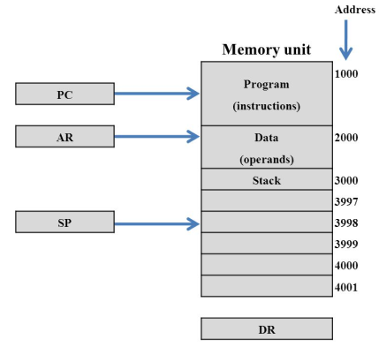
Memory Stack Operations

Slide 10
Advantages and Disadvantages
Advantages:
Large Capacity
Flexible Usage – can store data, return addresses.
Supports Recursion – enables functions to call themselves safely.
Efficient Subroutine Handling – simplifies function call and return.
Disadvantages:
Slower than Register Stack – accessing memory takes more time than registers.
Overhead – frequent PUSH/POP to memory may reduce performance.
Stack Overflow/Underflow Risk – incorrect handling can crash program.
Security Risk – stack overflows can be exploited (e.g., buffer overflow attacks).

Slide 11
Applications
1. Expression Evaluation
-Converting infix to postfix and evaluating expressions.
-Example: (A + B) * (C – D) → AB+CD-* → evaluated using stack.
2. Function Calls and Recursion
-Stores return address, local variables, and parameters.
-Supports recursive functions like factorial, Fibonacci, etc.
3. Interrupt Handling
-Saves CPU state (PC, flags, registers) during interrupt.
-Restores state after servicing.
4. Temporary Storage
-Useful for intermediate results in arithmetic/logic operations.

Slide 12
Register Stack Vs Memory Stack
Feature | Memory Stack | Register Stack
Storage | In main memory (RAM) | In CPU registers
Size | Large (depends on memory) | Very small (e.g., 8–32 registers)
Speed | Slower (memory access required) | Very fast (register access)
Cost | Cheaper (uses RAM) | Expensive (requires hardware)
Use Case | Function calls, recursion, interrupts | High-speed temporary operations

Slide 13
Activity-1(Think Pair Share)
Work in groups to trace
Push-Pop operations for the memory stack and the difference between the register and memory stack.
.

Slide 14
Activity-2(Hands-on)
Qus: A system uses a memory stack that grows downward (from higher to lower memory addresses).
Each stack entry is 2 bytes (16 bits) wide. The stack pointer (SP) initially contains the value 5000H.
Perform the following operations and show the contents of SP after each:
PUSH 1234H
PUSH 5678H
POP
PUSH 9ABCH

Slide 15
Summary
A memory stack is a section of RAM used to store temporary data like return addresses, parameters, and local variables.
It works on the LIFO (Last In, First Out) principle.
The Stack Pointer (SP) register keeps track of the top of the stack.
PUSH operations store data by decrementing SP (in downward-growing stacks) and writing to memory.
POP operations retrieve data by reading from memory and incrementing SP.

Slide 16

Post Session Activity –
Share this link: https://app.wooflash.com/moodle/HBVQ6K2A
Share this code: HBVQ6K2A
QR code:

Slide 17

Review and Reflection from students
Qus: Evaluate the following expression by using memory stack-
(3 * 4) + (5 * 6)

Slide 18
Thanks

